Slide 1
UNIT 2
Search Methodologies

Slide 2
Problem Solving as Search
A problem consists of a goal and a set of actions that can be taken to lead to the goal.
Consists of initial state, goal state and intermediate states
Search is a method computers can use to examine a problem space to find a goal.
A problem space is a search space because to solve the problem, we will search the space for a goal state.

Slide 3
Approaches
Two main approaches to searching a search tree
Data Driven and 2. Goal Driven
Data Driven:
Starts from an initial state and uses actions that are allowed to move forward until a goal is reached.
This approach is also known as forward chaining.
Ex: Analyzing astronomical data to make deductions about the nature of stars and planets (goal is not known here)
Goal Driven:
Search starts at the goal and works back toward a start state, by seeing what moves could have led to the goal state.
This approach is also known as backward chaining
Ex: Maze problem - easier to start from the end point and work back toward the start point. Because of many dead end paths set up from the start (data), and only one path set up to the end (goal) point

Slide 4
Generate and Test
Involves generating each node in the search space and testing it to see if it is a goal node.
Simplest form of brute-force search (also called exhaustive/blind search)
Assumes no additional knowledge but how to traverse the search tree and how to identify leaf nodes and goal nodes,
Examines every node in the tree until it finds a goal.
Needs to have a suitable Generator, which should satisfy three properties:
It must be complete: must generate every possible solution
It must be nonredundant: not generate the same solution twice.
It must be well informed: should not examine possible solutions that do not match the search space

Slide 5
DFS and BFS
Self Study

Slide 6
Properties of Search Methods
Complexity
The time complexity of a method is related to the length of time to find a goal state.
The space complexity is related to the amount of memory
BFS has a time complexity of O(b^{d}) and DFS has O(b^{d})
BFS has a space complexity of O(b^{d}) and DFS has O(d)
Completeness
A search method is described as being complete if it is guaranteed to find a goal state if one exists
BFS is complete, but DFS is not because it may explore a path of infinite length and never find a goal node that exists on another path.

Slide 7
Optimality
A search method is optimal if it is guaranteed to find the best solution that exists.
BFS is optimal and DFS is not
Admissibility
An algorithm that finds a solution in the quickest possible time is called admissible
Irrevocability
Methods that do not use backtracking, and which therefore examine just one path, are irrevocable.
DFS is an example of revocable search and BFS is irrevocable

Slide 8
Depth-First Iterative Deepening
Is an exhaustive search technique that combines depth-first with breadth-first search.
The DFID algorithm involves repeatedly carrying out DFS on the tree, starting with a DFS limited to a depth of one, then a depth-first search of depth two, and so on, until a goal node is found.
Combines the memory efficiency of DFS and time efficiency of BFS (finds the path that involves the fewest steps )

Slide 9
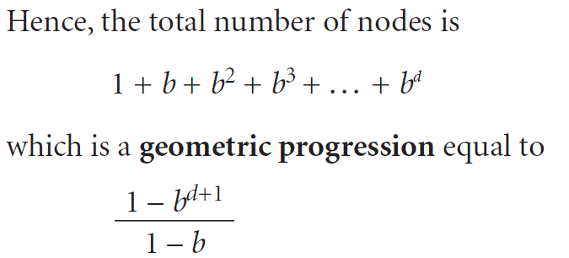
Calculation of Number of Nodes in a Tree
For a tree of depth d and with a branching factor of b, the total number of nodes is
1 root node
b nodes in the first layer
b² nodes in the second layer
. . .
b^{n} nodes in the n^{th} layer

Slide 10
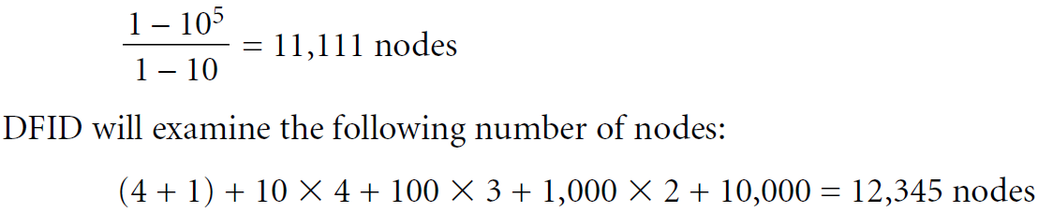
Using DFID, nodes must be examined more than once, resulting in the following progression:
Ex:
With a depth of 4 and a branching factor of 10, the tree has the following number of nodes:

Slide 11
Informed and Uninformed Methods
A search method or heuristic is informed if it uses additional information about nodes to decide which nodes to examine next.
If a method does not use additional information is uninformed, or blind.
In other words, search methods that use heuristics are informed, and those that do not are blind.
Choosing a Good Heuristic
Some heuristics are better than others, and the better (more informed) the heuristic is, the fewer nodes it needs to examine in the search tree to find a solution.

Slide 12
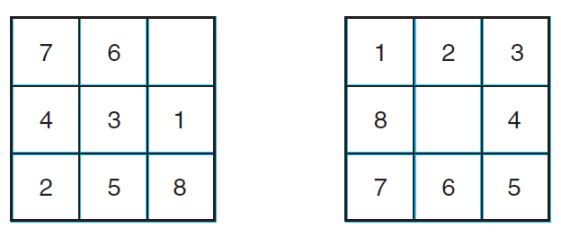
The 8-puzzle
The puzzle consists of a 3X3 grid, with the numbers 1 through 8 on tiles within the grid and one blank square. Tiles can be slid about within the grid, but a tile can only be moved into the empty square if it is adjacent to the empty square.
Start State Goal State

Slide 13
The first heuristic we consider is to count how many tiles are in the wrong place. We will call this heuristic, h1(node).
h1 = 8 (all are in wrong place)
An improved heuristic, h2, takes into account how far each tile had to move to get to its correct state. This is achieved by summing the Manhattan distances of each tile from its correct position.
h2 (node) = 2 + 2 + 2 + 2 + 3 + 3 + 1 + 3 = 18

Slide 14
Monotonicity
A search method is described as monotone if it always reaches a given node by the shortest possible path.
Using Heuristics
DFS and BFS are brute-force search methods. This is because they do not employ any special knowledge of the search trees
Heuristic is defined as the additional information or knowledge that helps in searching the solution in Search trees

Slide 15
Best First Search
Best-first search employs a heuristic
It uses an open queue to maintain the unvisited nodes
A closed queue is used to maintain the visited and closed nodes

Slide 16
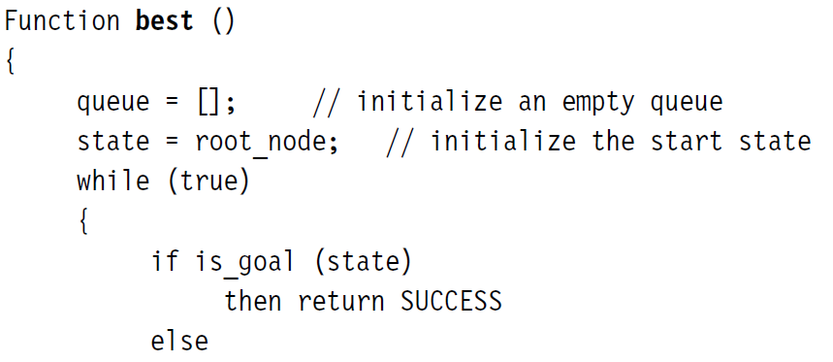
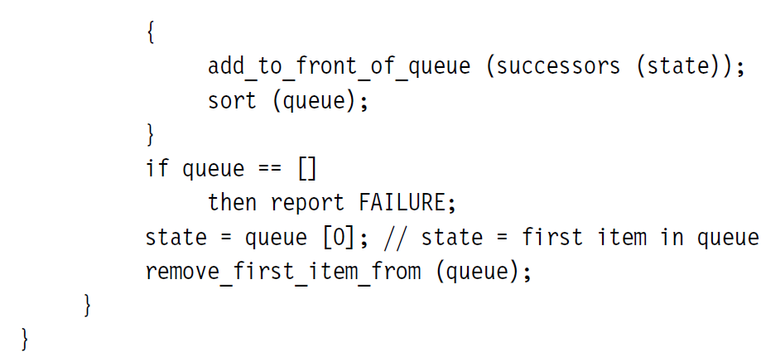
Function of Best First Search

